Slide 1
Linear Regression with Multiple Variables a.k.a Multivariate Regression
.

Slide 2
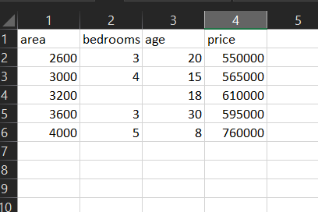
Home prices in Delhi , India
Given these home prices find out price of home that has,
3000 sqr ft area, 3 bedrooms, 40 year old
2500 sqr ft area, 4 bedrooms, 5 year old

Slide 3
Price = m1 * area + m2 * bedrooms + m3 * age + b
Independent Variables (features)
Dependent variable
Coefficients
Intercept
Y= m1x1 + m2x2 +m3x3 +b

Slide 4
TOPICS-
Data Preprocessing: Handling NA values
Linear Regression Using Multiple Variables

